Slide 1
The Analysis of Dallas Resident’s Preferences among Dallas Cowboys, Dallas Mavericks, and Texas Rangers
Allison Gordon
Sashank Ketavarapu Srinivas
Deepak Sivaraman
Ramkumar Sreeram
Yu-Min Wang

Slide 2
Problem
Client: Dallas Cowboys, Dallas Mavericks, and Texas Rangers, with a focus on the Cowboys
Compare brand image and preferences of three teams
Find significant demographic factors for attendance and preference of Cowboy games
Find factors that affect the preferences of each sport team
Value: find a deeper understanding of the fans for each Dallas team.

Slide 3
Research Design
Descriptive Research
Quick
Cheap
Cross-sectional
Measure at one point in time
Population: Dallas area
Sample-Frame: Friends and families in Dallas area

Slide 4
Sampling
Convenience sampling
Other UTD students
Friends
Families
Snowball effect
Limitations
Could be biased
Only generalizations
83 responses

Slide 5
Questionnaire Design
Likert scale
Preference questions
Comparative rating scale
Categorical questions
Ordinal questions
Demographic questions

Slide 6
Likert Scale
Please indicate the extent to which you agree or disagree with each of the following statements using the guide below:
5: Strongly Agree
4: Agree
3: Neither Agree Nor Disagree
2: Disagree
1: Strongly Disagree
I am a fan of the Dallas Cowboys
1 2 3 4 5
I am a fan of the Dallas Mavericks
1 2 3 4 5
I am a fan of the Texas Rangers
1 2 3 4 5

Slide 7
Preference Questions
Please Indicate your preferences about the Team Performance from 0-100, where 100 represents the most satisfaction and 0 represents the least:
Cowboys
Mavericks
Rangers
Please indicate your satisfaction about the Community Service/Charity sponsored by each team, where 100 represents your most satisfaction and 0 represents the least:
Cowboys
Mavericks
Rangers
Please indicate your satisfaction about the interactions with Fans of each team, where 100 represents your most satisfaction and 0 represents the least:
Cowboys
Mavericks
Rangers

Slide 8
Comparative Rating Scale
If you have $100 budget to spend on the three teams, how would you allocate your expenditure?
Cowboys
Mavericks
Rangers
If you have 100 hours to spend in watching the games of the three teams, how would you allocate your time
Cowboys
Mavericks
Rangers

Slide 9
Demographics
Gender
Age
Race
Marital status
Household size
Level of education
Income

Slide 10
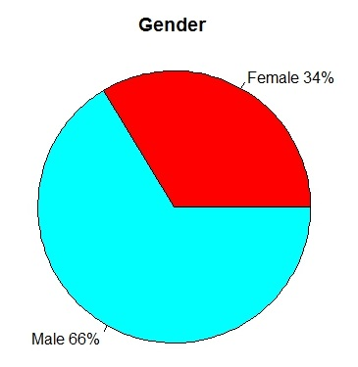
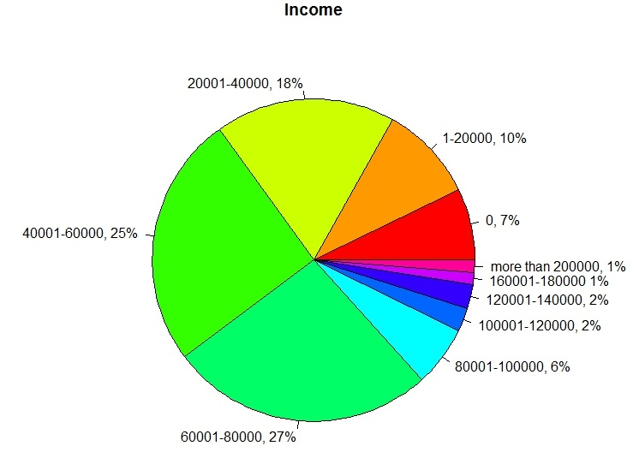
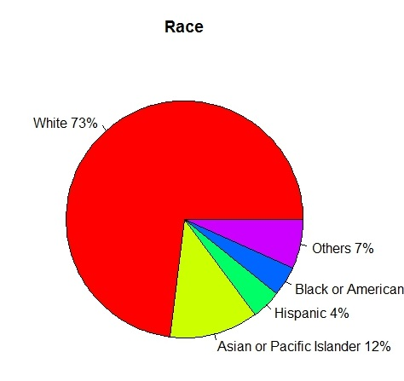
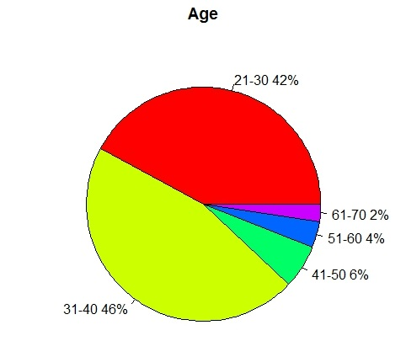
Respondents Distribution (n=83)

Slide 11
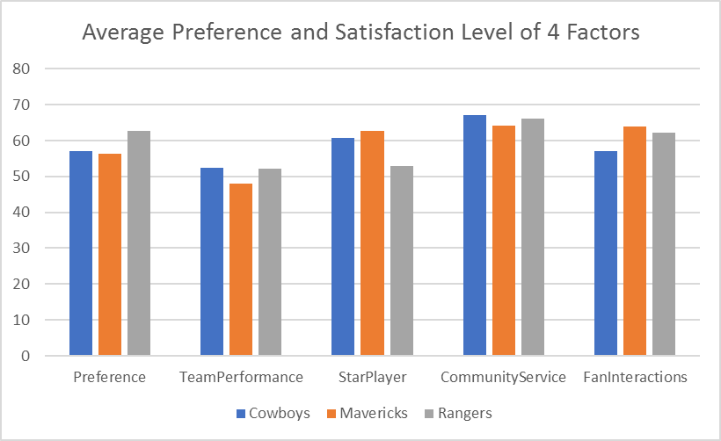
Descriptive Statistics

Slide 12
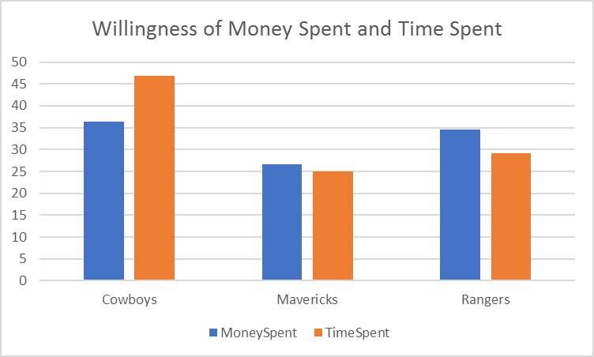
Descriptive Statistics

Slide 13
ANOVA Test 1
µ1: Mean preference of Dallas Cowboys µ2: Mean preference of Dallas Mavericks µ3: Mean preference of Texas Rangers H₀: µ1 = µ2 = µ3
H₁: At least two means differ

Slide 14
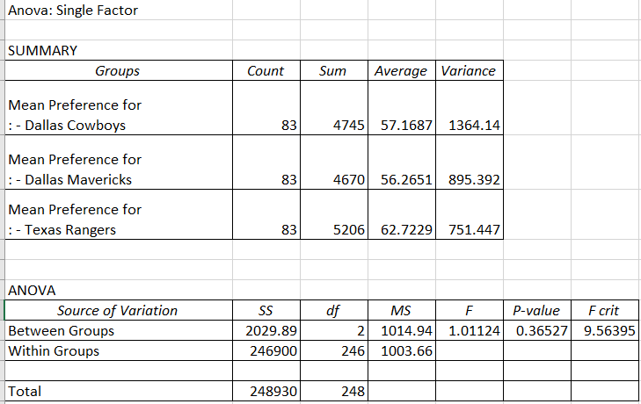
Fail to reject H₀. People have equal preference with respect to the three teams

Slide 15
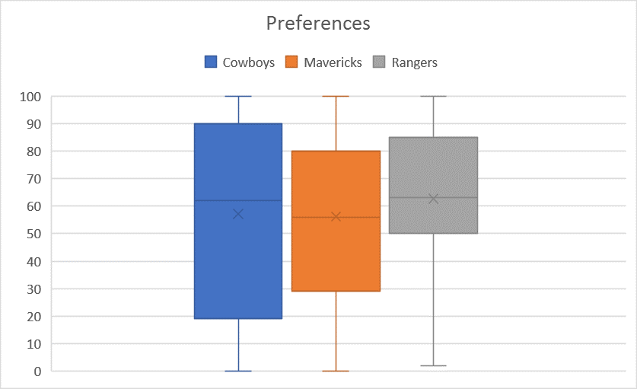

Slide 16
ANOVA Test 2
µ1: Mean money spent of Dallas Cowboys µ2: Mean money spent of Dallas Mavericks µ3: Mean money spent of Texas Rangers
H₀ : µ1 = µ2 = µ3
H₁ : At least two means differ

Slide 17
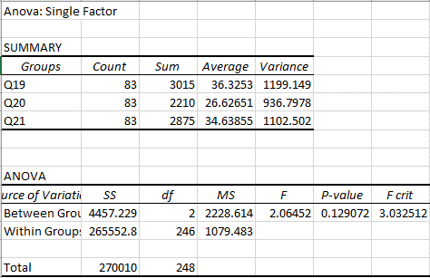
Fail to reject H₀. People spend the same amount of money with respect to the three teams

Slide 18
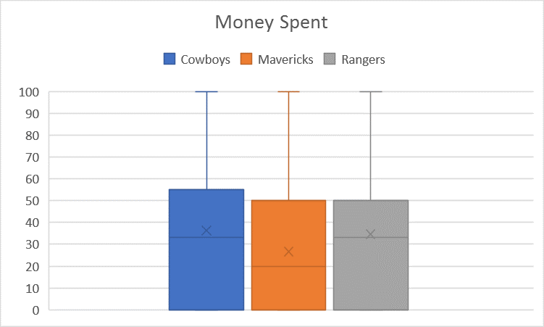

Slide 19
ANOVA Test 3
µ1: Mean of time spent watching the Dallas Cowboys µ2: Mean of time spent watching the Dallas Mavericks µ3: Mean of time spent watching the Texas Rangers
H₀ : µ1 = µ2 = µ3
H₁ : At least two means differ

Slide 20
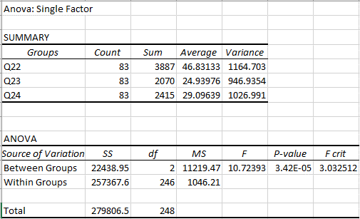
Reject H₀. At least two teams differ in hours spent watching

Slide 21
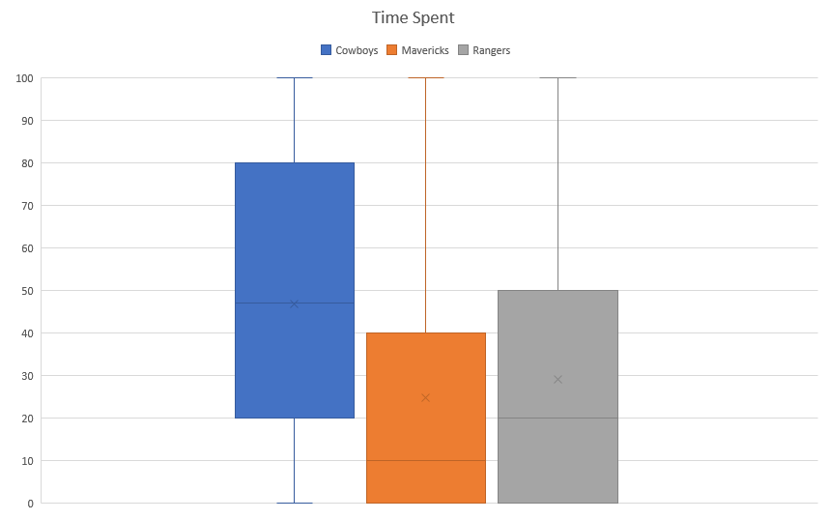

Slide 22
Gender and Cowboys Game Attendance
Chi-square test
H₀ : the two variables are independent
H₁ : the two variables are related
Pearson's Chi-squared test with Yates' continuity correction
data: surveyTable$Q25 and surveyTable$Q26
X-squared = 5.4864, df = 1, p-value < .01916
Reject Ho. Being male or female has an effect on whether someone attends a Cowboys game.

Slide 23

Other Demographics
Only gender has a relationship with attendance of Cowboy games.

Slide 24
Gender Preferences in Dallas Cowboys
H₀ : No difference in preference for the Dallas Cowboys between male and female
H₁ : There is a difference in preference between male and female

Slide 25
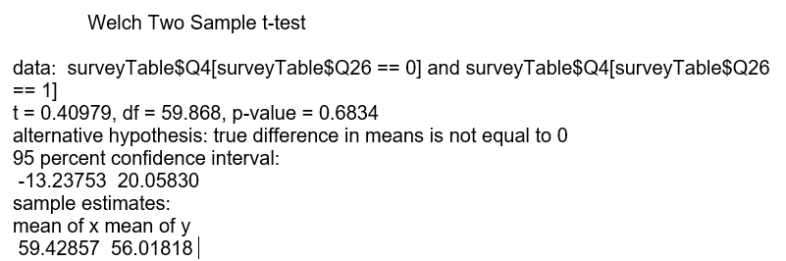
Fail to reject H₀. There is not a difference in preference between male and female.

Slide 26
Why?
Gender has a relationship with attendance of Cowboys games, but
There is not a difference in preference between male and female.
We find no women attending Cowboys games even though they love Cowboys.
Only men attend Cowboys games.

Slide 27
Why do people love the Cowboys?
Dependent variable: Preference for the Dallas Cowboys
Independent variables:
Team performance
Love for star players
Community service
Interactions with fans
Y = Intercept + b1X1 + b2X2 + b3X3 + b4X4

Slide 28
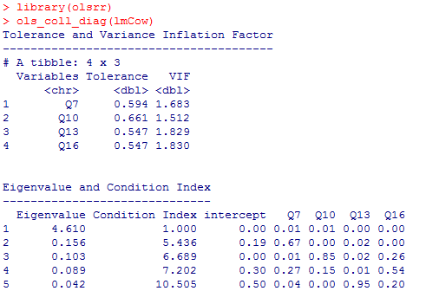
Collinearity Diagnosis
There is no collinearity in the 4 independent variables because all CI<30 and VIF<10.

Slide 29
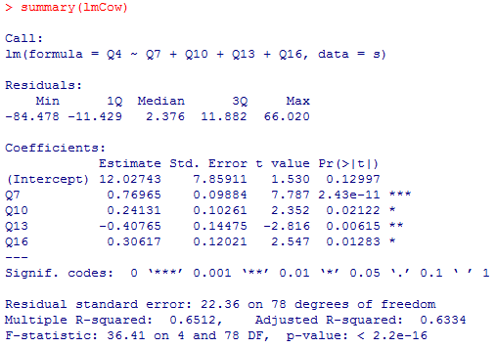
F-stat = 36.41 and P-value ~ 0
Good Model
Adjusted R-Squared = .63

Slide 30
Predicted Preference for cowboys = 12.02 + 0.7697*Team’s Performance + 0.2413 *Love for Star Players – 0.4077*Community Service + 0.3062*Interaction with fans
Interpretation: 1. One point increase in Community Service satisfaction has negative impact of 0.4077 points decrease in Team’s Preference among people keeping others constant. On average, Dallas Cowboys has 67 points with respect to community service. 2. Team’s Performance has highest impact in Team’s preference. 1 point increase in Team’s performance has almost 0.8 points increase in Team’s preference which is a huge impact.

Slide 31
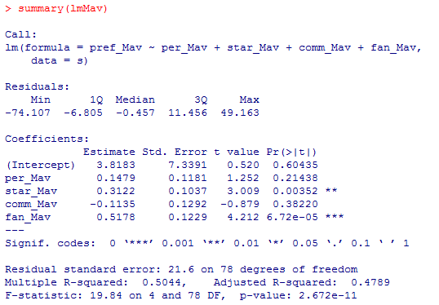
Why do people love the Mavericks?

Slide 32
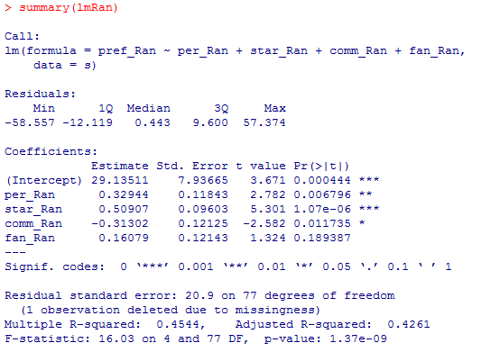
Why do people love the Rangers?

Slide 33
Strategic Implications
Community service has negative impact on team preference
Recommendation: Spending on charity can be reduced and used for scouting, training, fitness,…etc.
Team performance has the biggest impact on preference
Recommendation: extensive training for players, pulling in experienced coach, nutritious supplements and healthy lifestyle, player motivation, etc.
Female do not attend Cowboys games
Recommendation: further research could be done to determine the reasons behind this

Slide 34
Strategic Implications
No significant difference in the preferences of the three teams or the willingness to spend money for the three teams. People are willing to spend more time on the Cowboys in comparison with the Mavericks and the Rangers.
Recommendation: Cowboys can figure out some competitive strategy to take advantage of this

